Slide 1

Safety floater
IoT group project for coastal tourism
Blue Growth
Daniele Bufalieri, Marco Calamo, Ivan Giacomoni

Slide 2
What is the problem?
The problem is the security of swimmers because of the boats that do not respect the safety distance from the coast.
It is a threat for the tourists and also for the environment because the pollution near the shore.
There is not a direct communication to the authorities

Slide 3
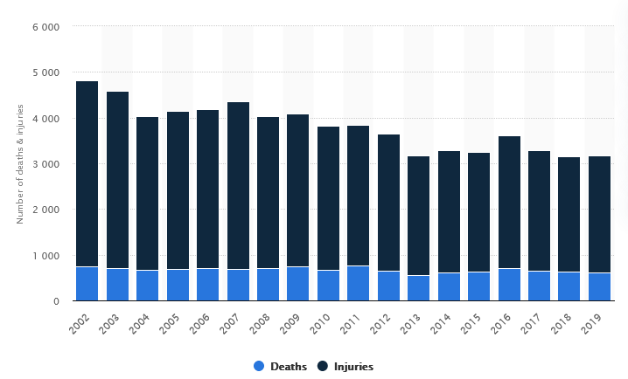
Boat accidents FROM 2002 TO 2019

Slide 4
Key functionalities
Real time reporting to authorities of violations
Create a safer holiday for tourists
Improve water quality near the shore
Decrease number of accidents
Provide an user friendly dashboard in order to monitor violations

Slide 5
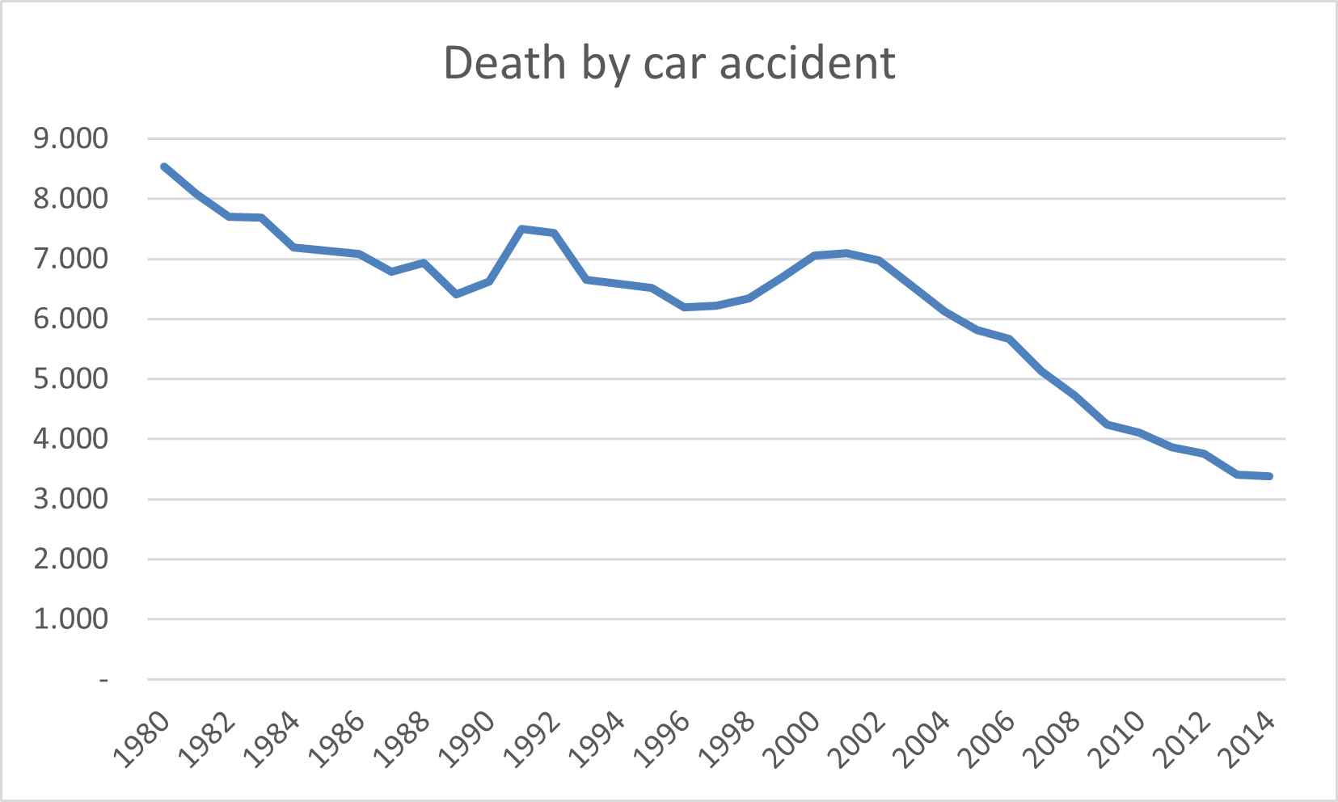
Collective intelligence
Our purpose is to replicate this trend of death by car accident since autovelox was introduced, but in the context of accident caused by boats introducing our system in order to prevent an increasing number of deaths.

Slide 6
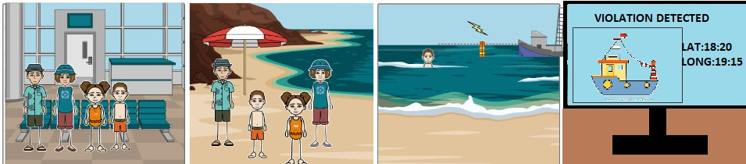
Scenarios
Bob is in Sardinia with his family on vacation. One day, his son is swimming in the water nearby, Bob sees a boat approaching too close to safety line, but thanks to the Safety Floater system control his son is not really in danger, because authorities will intervene in time.

Slide 7
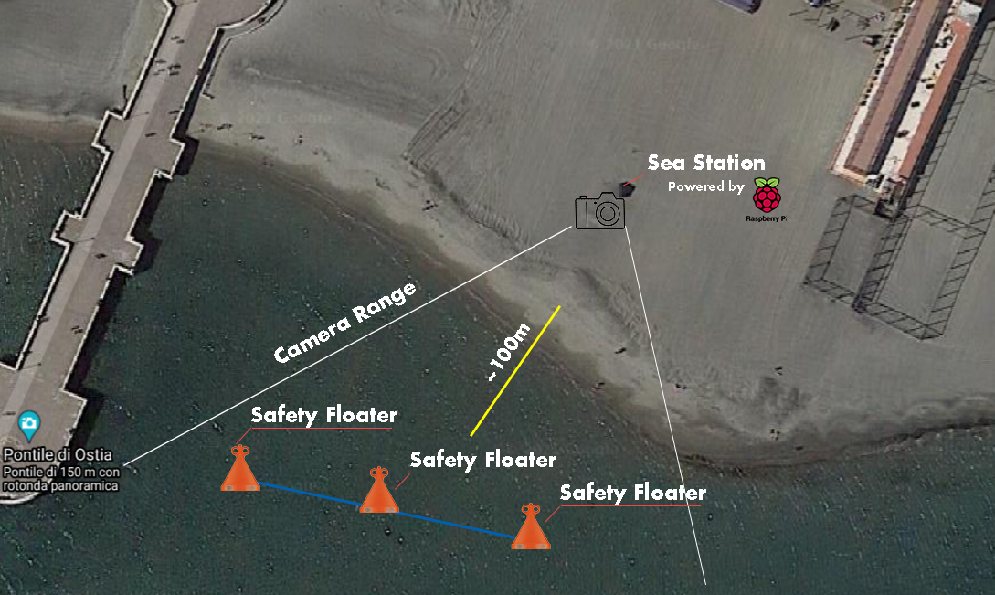
DEPLOYMENT

Slide 8
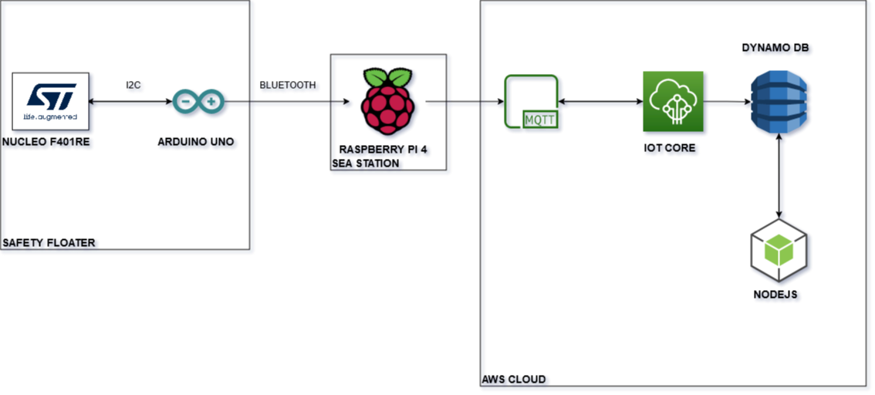
IOT ARCHITECTURE: DETAILED SUMMARY

Slide 9
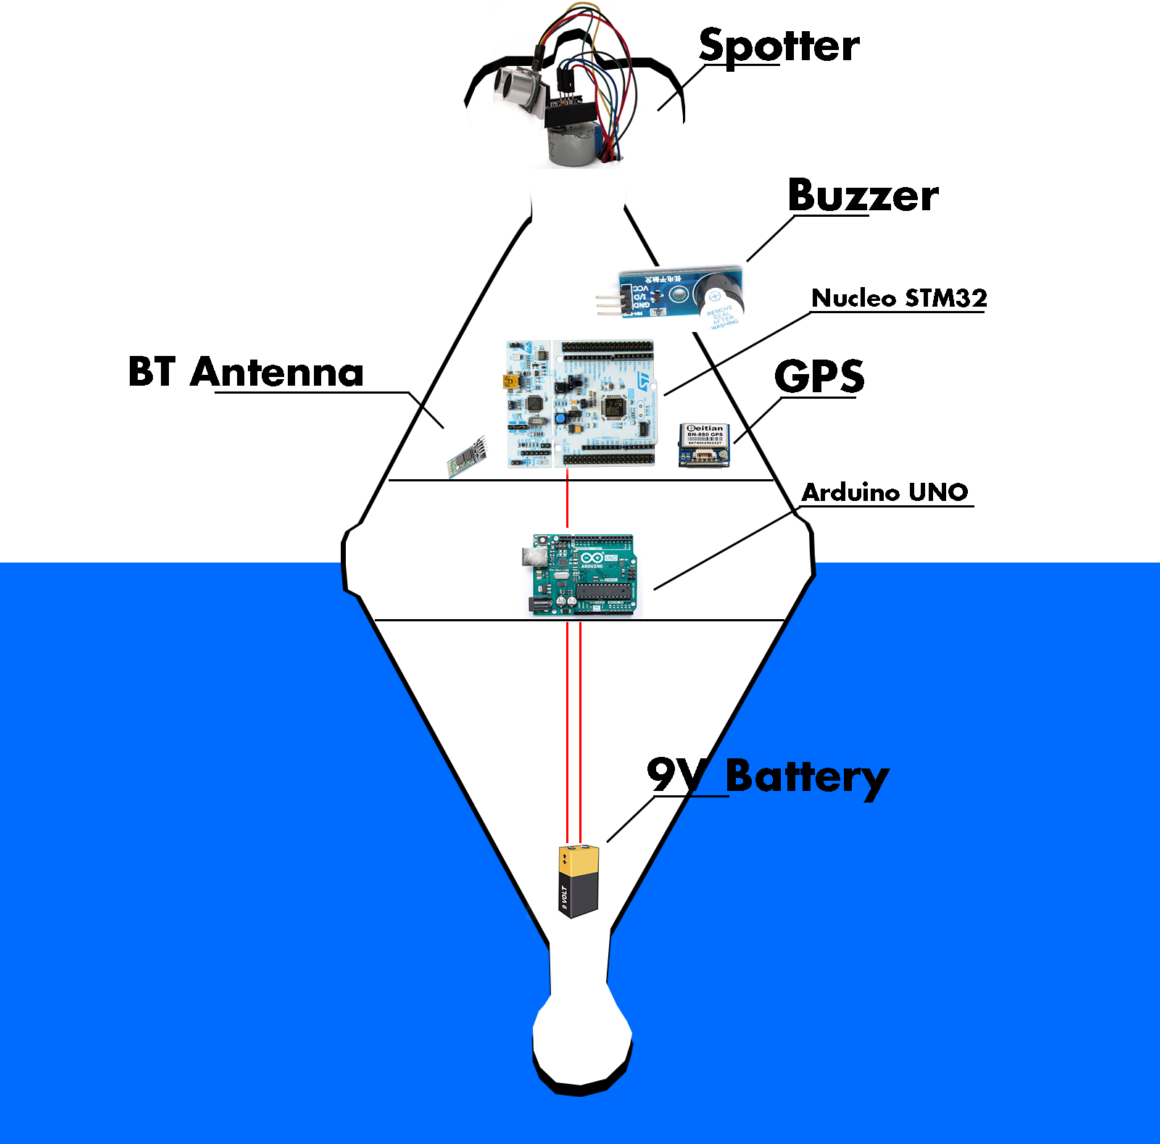
SAFETY FLOATER VIEW
In this version we used an Arduino Uno board in order to simplify the prototyping step
The spotter is our approach to detect the violations and keep the correct orientation also in the rough sea
The battery is on bottom in order to have a stabilized structure

Slide 10
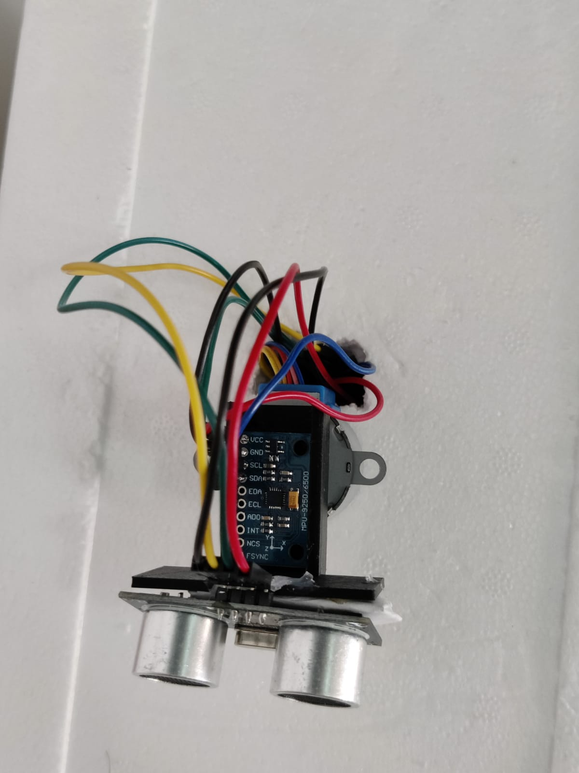
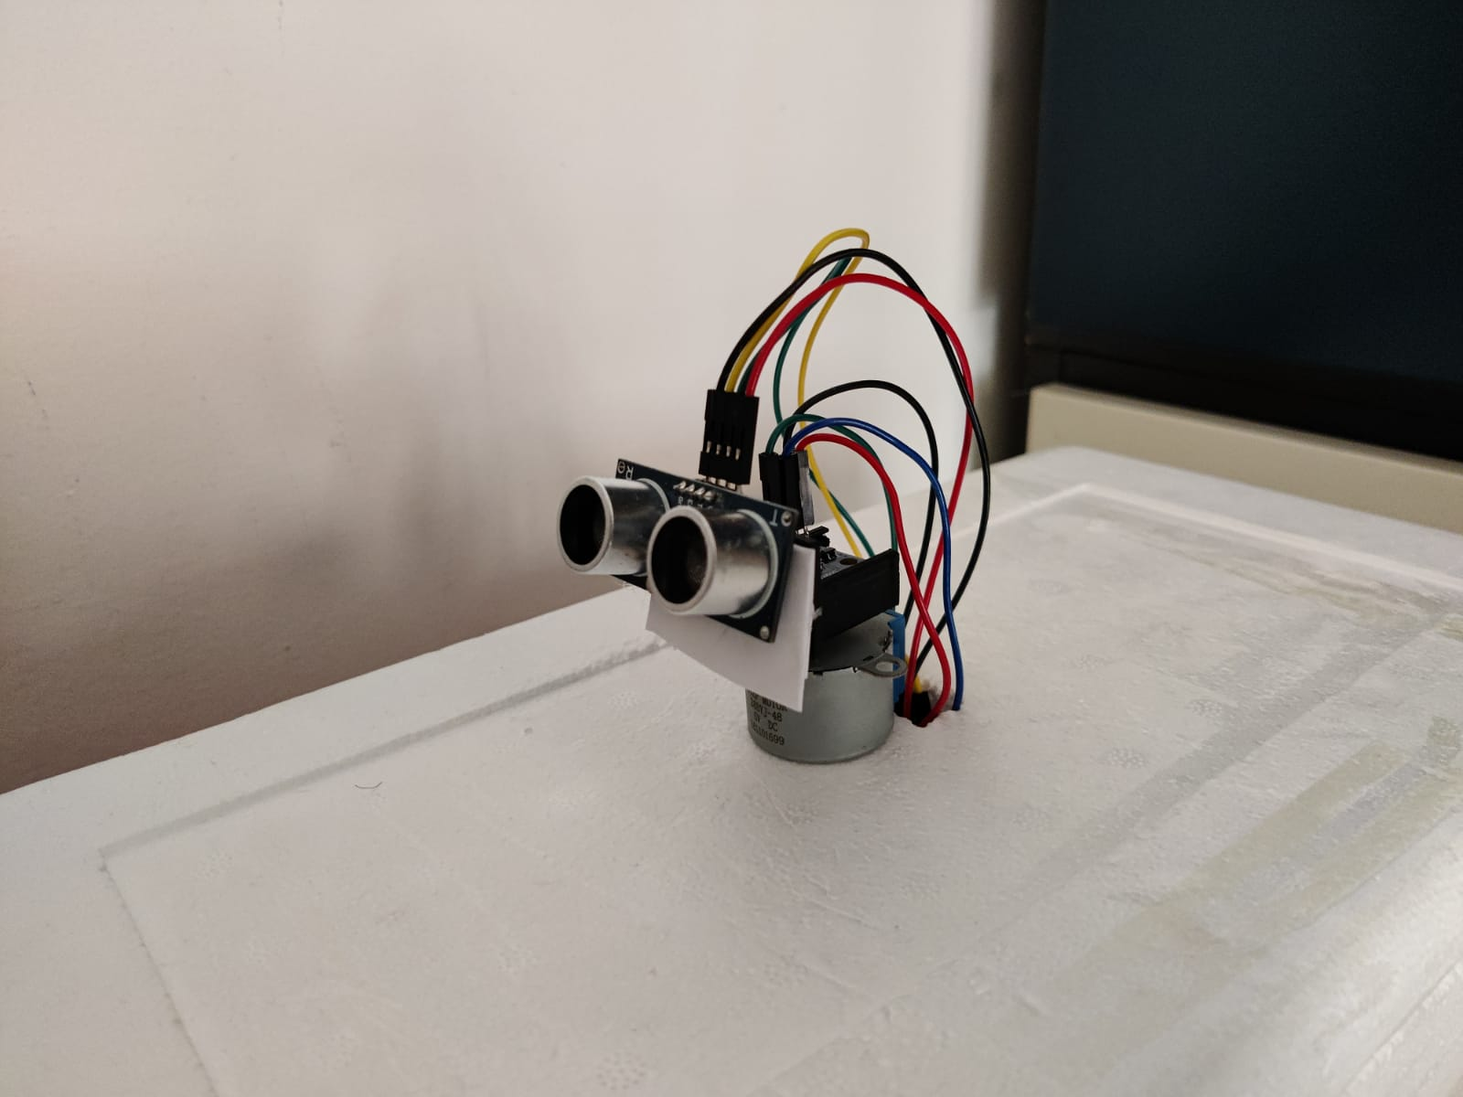
SPOTTER VIEW
MPU-9250 GYROSCOPE
HCSR-04 PROXIMITY SENSOR
STEPPER MOTOR

Slide 11
SAFETY FLOATER: FUNCTIONALITIES
Boat detection mechanism
Orientation control mechanism
Power management mechanism

Slide 12
BOAT DETECTION MECHANISM
SAFETY FLOATER
SEA STATION
CLOUD
SOMETHING DETECTED
WAIT FOR DETECTION
BUZZER SOUND + NOTIFICATION SENDING TO SEA STATION
NO
UPLOAD TO DASHBOARD
PICTURE + CNN ANALYSIS
IS BOAT?
YES

Slide 13
ORIENTATION CONTROL MECHANISM
VIDEO

Slide 14
POWER MANAGEMENT MECHANISM
High power consumption mode: the sea is calm, and we sample from the gyroscope every 100 μs, because is the most power demanding, while other sensors need to be constantly sampled
Medium power consumption mode: the sea is in mild conditions, it is less probable that boats will come, so we can sample the gyroscope every 10 seconds, while other sensors need to be constantly sampled with larger delays
Low power consumption mode: the sea is rough, it is almost impossible that boats will come, so we can sample the gyroscope every one minute, while other sensors need to be constantly sampled with even larger delays

Slide 15
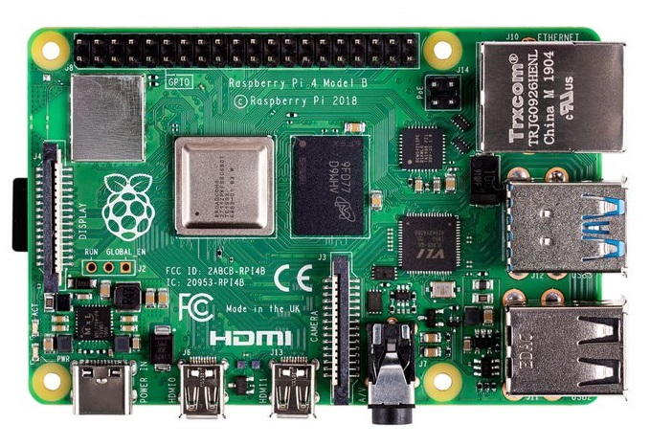



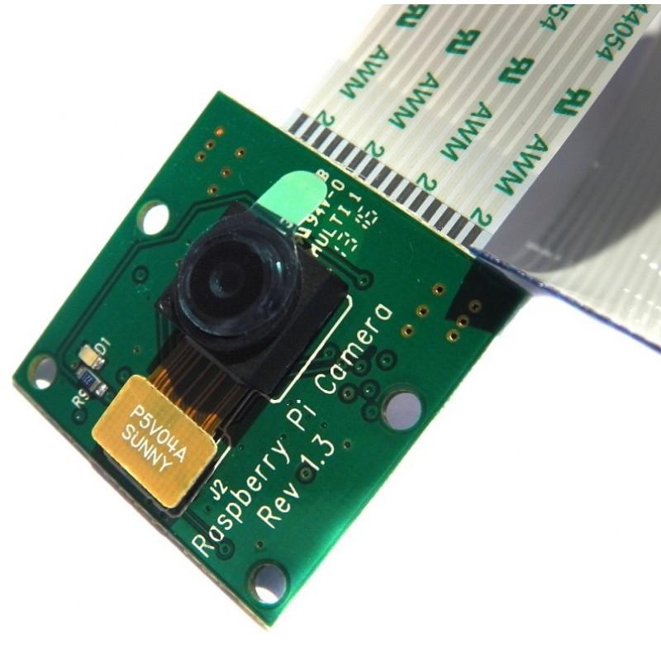
Sea station: structure & Communication
RASPBERRY PI 4
FROM SAFETY FLOATER
TO AWS
CLOUD
CAMERA

Slide 16
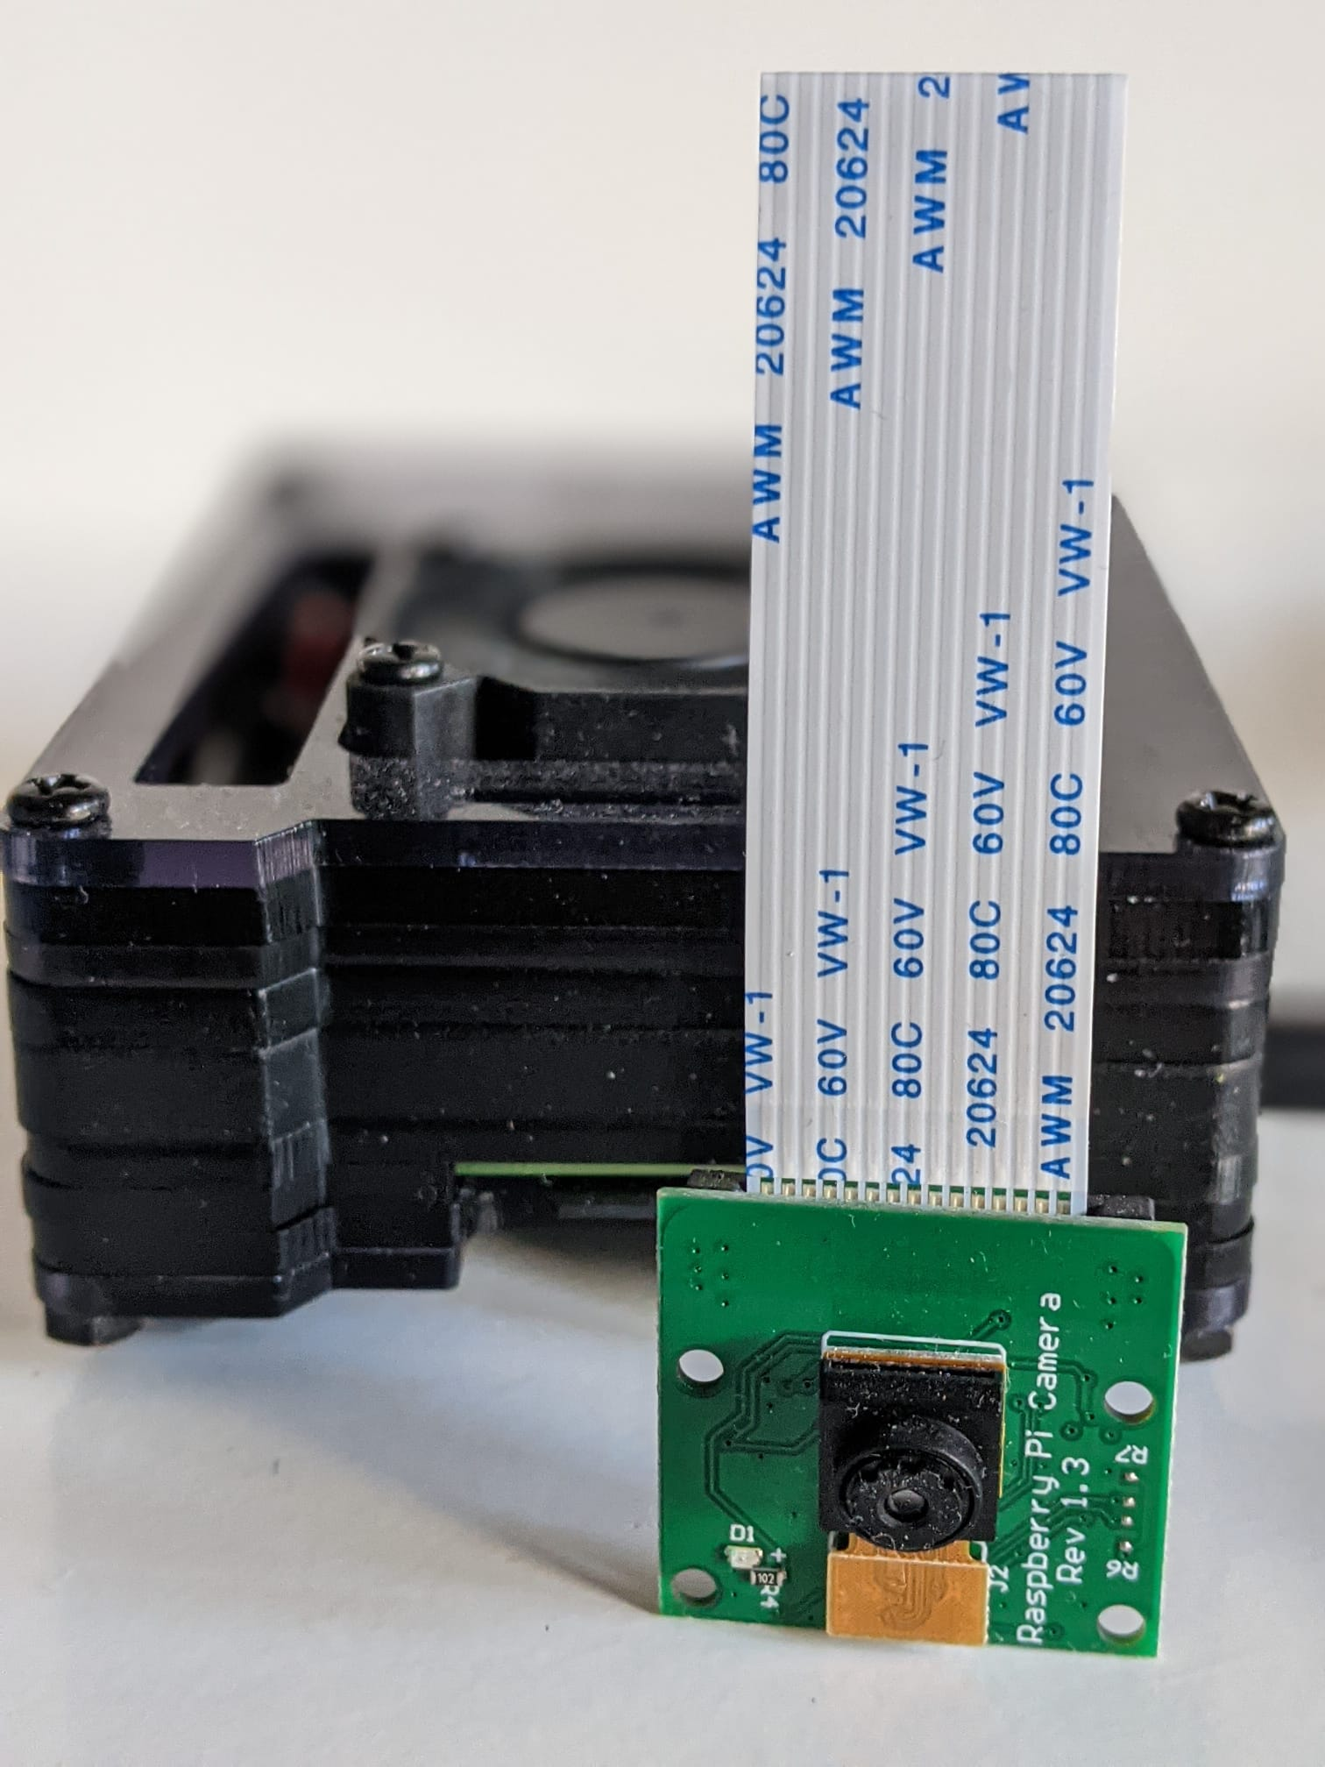
SEA STATION: FUNCTIONALITIES
Ground-sea communication
Boat recognition system
Ground-cloud communication

Slide 17
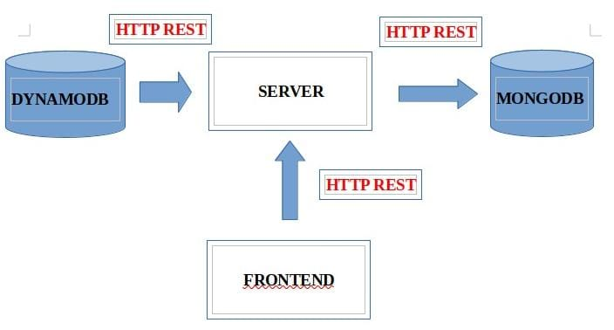
CLOud server & FRONTEND: structure

Slide 18
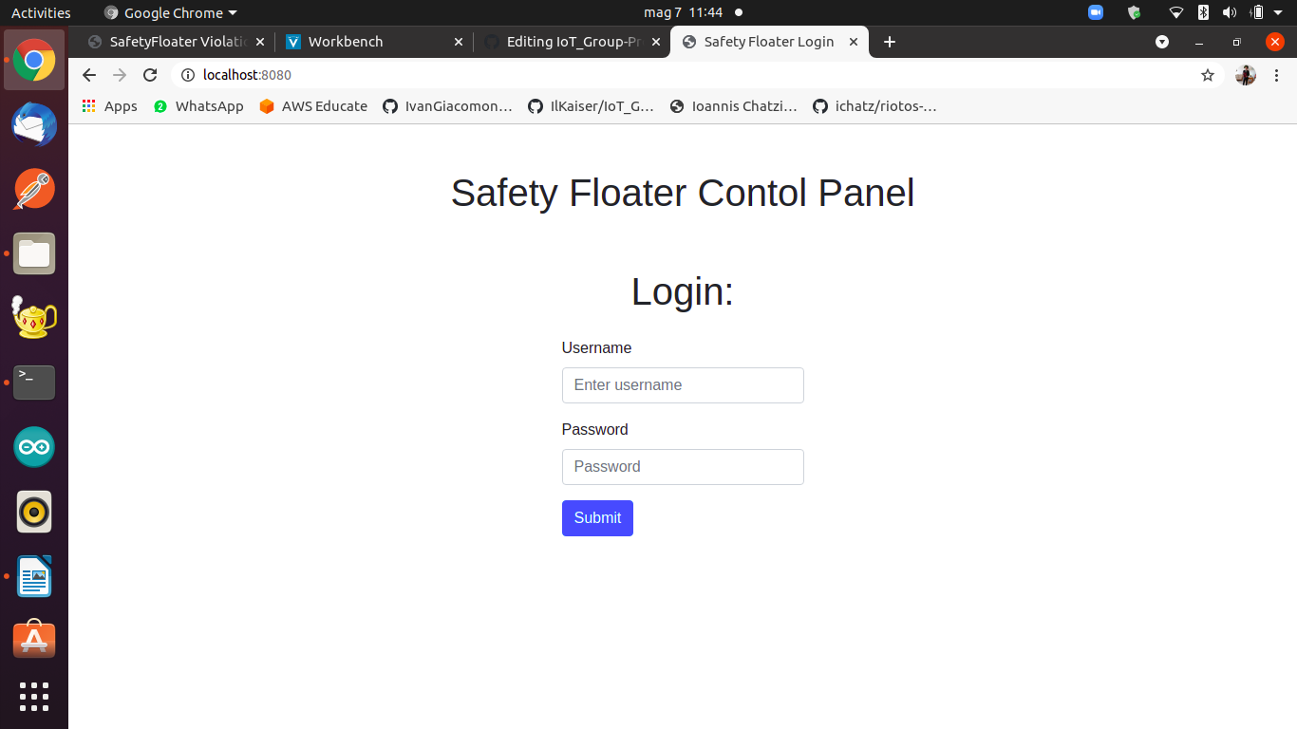
CLOud server & FRONTEND: FUNCTIONALITIES

Slide 19
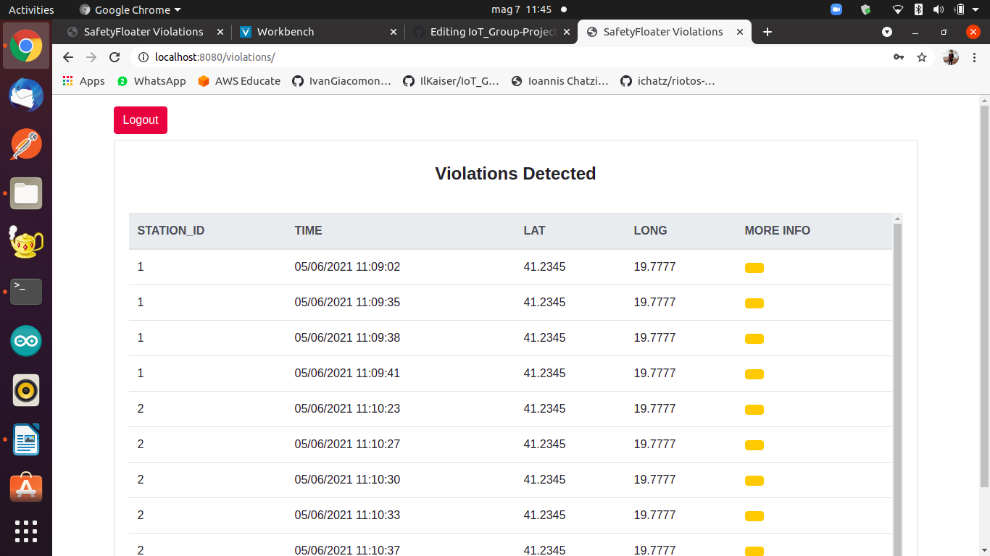
CLOud server & FRONTEND: FUNCTIONALITIES

Slide 20
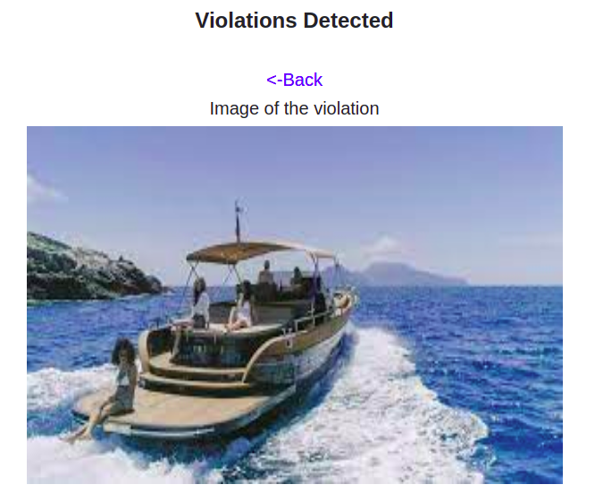
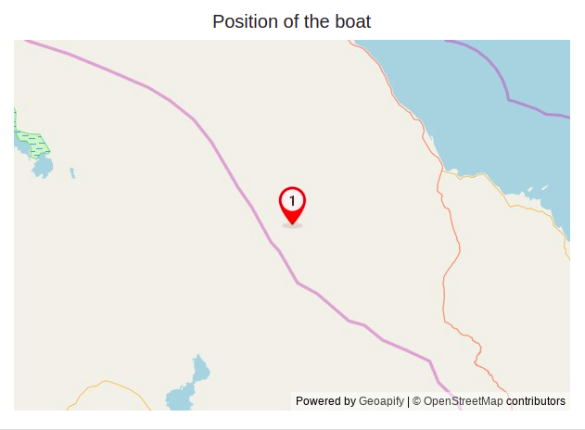
CLOud server & FRONTEND: FUNCTIONALITIES
1

Slide 21
Constraints
All sensors are constantly sampled
Bandwith and latency limitated by the capacity of LoraWAN
Waterproof sensors
Energy is a key factor in Safety Floater, we use solar panel in order to increase the battery life
Power consumption reduced at minimum

Slide 22
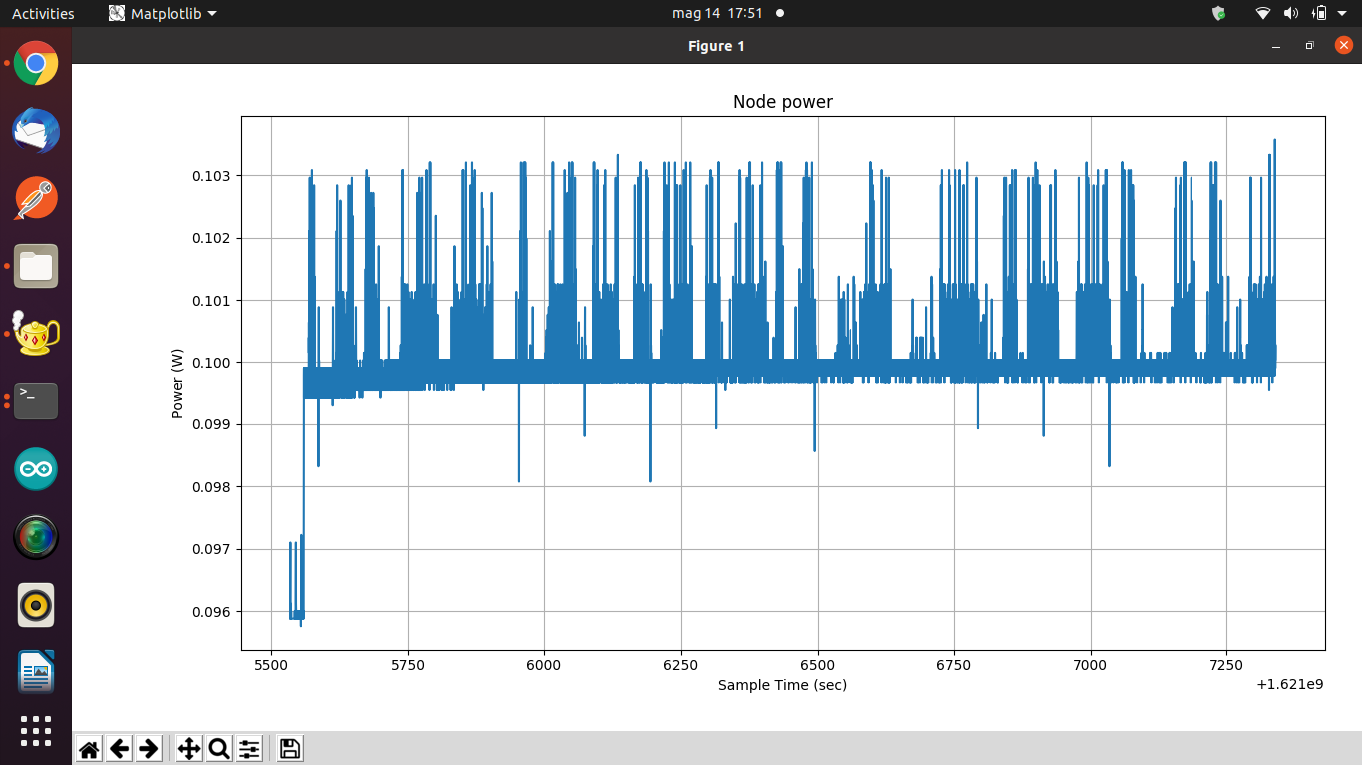
Evaluation & PERFORMANCE: power consumption mode 1

Slide 23
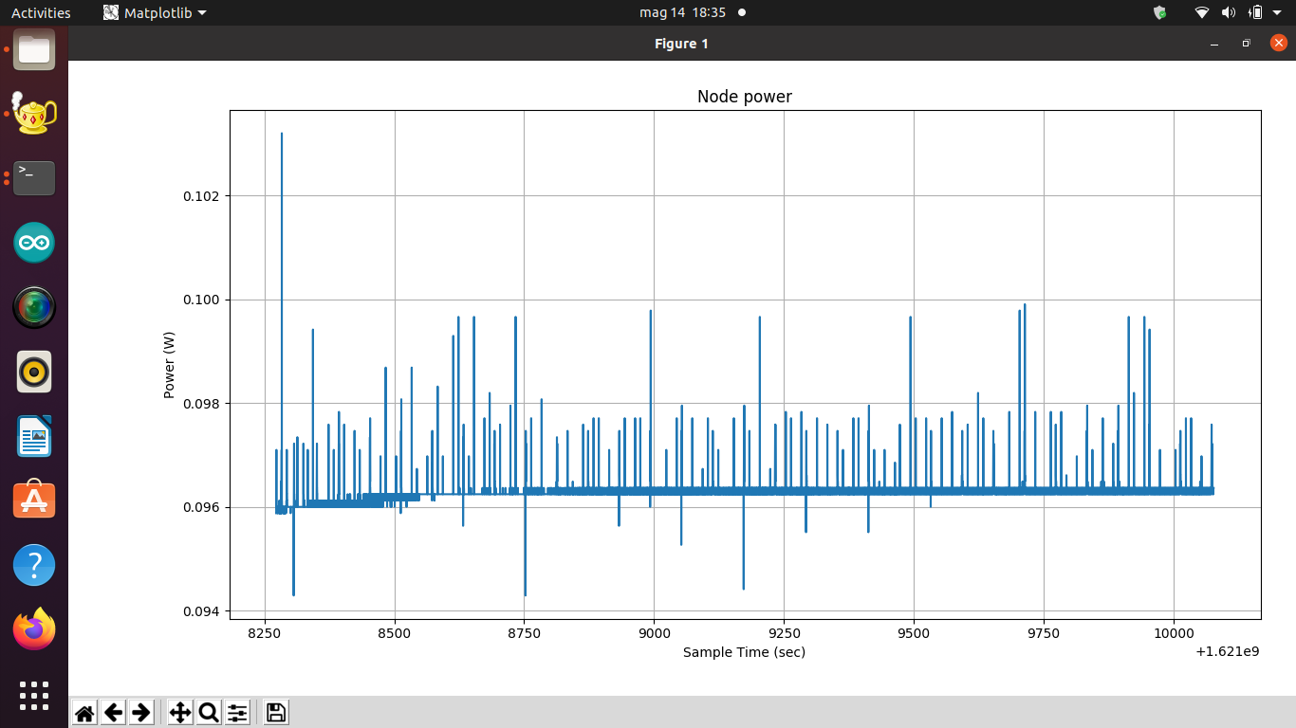
Evaluation & PERFORMANCE: power consumption mode 2

Slide 24
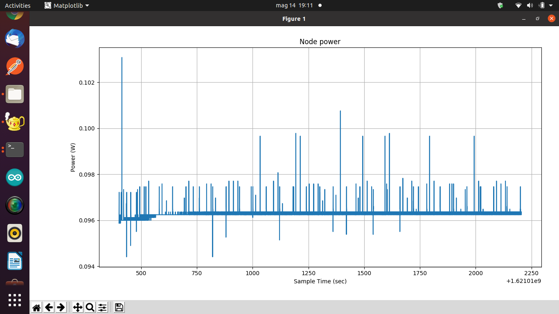
Evaluation & PERFORMANCE: power consumption mode 3

Slide 25
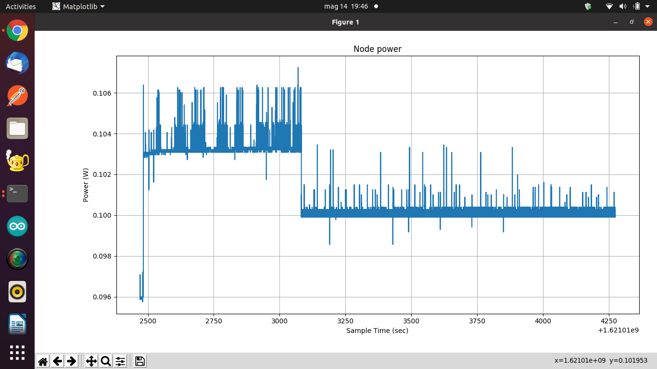
Evaluation & PERFORMANCE: power consumption general

Slide 26
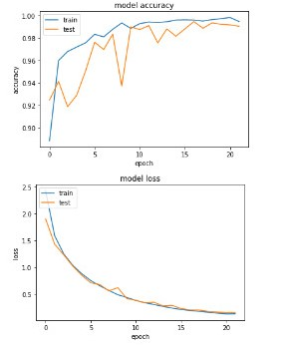
Evaluation & PERFORMANCE: boat detection

Slide 27
Evaluation & PERFORMANCE: NETWORK latency
I2C: STM->ARDUINO (0.001 S)
BLUETOOTH: ARDUINO->RASPBERRY (0.150 S)
PHOTO: RASPBERRY (3.000 S)
MQTT: RASPBERRY->CLOUD (0.050 S)
REST: CLOUD ->NODE (0.050 S)
REPORT AVAILABLE ON THE DASHBOARD (4.255 S)
I2C: STM->ARDUINO (0.001 S)
I2C:ARDUINO->STM(0.001 S)
Delay to detect false positive 1.000 S
I2C: STM->ARDUINO (0.001 S)
I2C:ARDUINO->STM (0.001 S)
BUZZER ACTIVATED (1.004 S)

Slide 28
Future development
Optimizing power management
Improving latency
Development of a better web interface
Introduction of Solar panel
Security
Use a better gyroscope, if possible

